Slide 1
NOENOVA
NeoNova Securing Digital Futures in Saudi Arabia
NeoNova leads cybersecurity excellence in Saudi Arabia.
We align with Vision 2030 to protect the Kingdom's digital landscape.
As trusted partners to government and private sectors, we deliver specialized security solutions for digital transformation.
communication and information technology
05/05/2025

Slide 2

NOENOVA
OUR
VISION
To be Saudi Arabia’s foremost partner in securing the digital future, empowering smart cities, critical infrastructure, and emerging technologies with cutting-edge cybersecurity solutions that drive national growth and resilience
05/05/2025

Slide 3
NOENOVA
OUR MISSION
To provide innovative cybersecurity solutions that protect Saudi Arabia's digital landscape, empowering smart cities and critical infrastructure. We strive to enhance national security and resilience through collaboration and advanced technologies, driving sustainable growth for the future.
05/05/2025

Slide 4

NEONOVA Core Values
1
Upholding the highest ethical standards, we build trust with our clients and partners
Integrity
2
Embracing advanced technologies to deliver transformative solutions at the highest quality.
Innovation and Excellence
Promoting best in class expertise driven by the power of collaboration and partnership, both Globally and Locally
3
Collaboration and Partnership
Supporting Saudi Arabia's strategic vision 2030 by nurturing local talent, advancing national capabilities, and safeguarding critical infrastructure.
4
National commitment
5
Customer Centricity
Tailored solutions to address the client’s specific needs

Slide 5

Products and services

Slide 6
Cybersecurity – Managed SOC Services
Govern. Defend. Comply. Your Security, Fully Managed.
Threat detection and response
Attack and penetration testing
Cyber threat intelligence
Vulnerability management
Threat hunting
Insider threat management
Compromise Assessment
CYBER SECURITY SERVICES

Slide 7
Cybersecurity – Managed SOC
Govern. Defend. Comply. Your Security, Fully Managed.
Threat detection and response
Cyber threat intelligence
Threat hunting and compromise Assessment
Attack and penetration testing
Vulnerability management
Insider threat management
We leverage advanced tools and threat intelligence to detect malicious activity early, respond quickly, and minimize business impact—ensuring continuous protection across your digital environment.
We collect, analyze, and share threat data to help organizations proactively identify risks, understand attacker behavior, and strengthen defenses before threats become incidents.
We perform controlled cyberattacks to test your systems, applications, and networks—identifying weaknesses before attackers can exploit them and helping you strengthen your security posture.
We provide continuous scanning, assessment, and risk-based prioritization of vulnerabilities across your environment—ensuring proactive protection and compliance with security standards.
We monitor user behavior and access patterns to identify potential insider threats—whether malicious or accidental—helping you protect sensitive data and maintain organizational trust.
Our experts actively search for advanced threats lurking in your environment and assess whether your systems have been compromised—helping you detect, respond, and strengthen your defenses.

Slide 8

NeoNova
Threat detection and response
A next-gen IT/OT/IoT SOC of NeoNova, effectively works and significantly reduces the response time to threats by applying Afiificial Intelligence technologies, Machine Learning and Big-Data to automate business processes and improve investigation capabilities.
NeoNova connects/collects all resources through agents/ log forwarders, setting up passive information collection points (SPAN/ TAP/Network broker, etc.), and using connectors/APIs for non-standard data types.
NeoNova uses Big-Data platform and various AI/ML applied engines with advanced algorithms and models for centralization and automation. NeoNova also provides continuous and comprehensive Cyber Security scenarios to help your organization respond timely to incidents. This is an impofiant element of Adaptive Security Architecture.
INVESTIGATE & RESPONSE EDR, IPS, WAF
OT/IOT
Analyze OT/IoT
THREAT
INTELLIGENCE
OSINT, CERTS...
®
SCALABILITY
Integration API
AUTOMATION
Automated respond
TECHNOLOGY
CONTINUOS
MONITORING
Operate analyze 24/7
CONTINUOS
CONTROL
Compliance check
PROACTIVE, CONTINUOUS, AUTOMATIC AND COMPREHENSIVE MONITORING
TIME ANALYZING, ALERTING AND RESPONDING TO THREATS
AI/ML, Big-Data...

Slide 9
NeoNova
Cyber threat intelligence
By collecting and analyzing information about cyber threats, NeoNova - Threat Intelligence is an active protection method which aims to provide your organization a deeper understanding of threats.
Using data collected in real-time from a variety of sources, NeoNova’s - Threat Intelligence offers comprehensive and up-to-date scenarios of potential threats to your organization.
DETECT
Detech bad news and hazards
ALERT
Detect, alert on leaked data
ANALYZE
Analyze collected
data from the systems
REPORT
Provide cyber security reports
THREAT INTELLIGENCE
COLLECT
Real-time collect data from social networks, forums, darknet,...
NEWS
Up-to-date cyber security news
®
DEEP UNDERSTANDING OF THREATS

Slide 10




NeoNova
Cyber threat Hunting
ACTIVE AND CONTINUOUS NETWORK SECURITY ASSESSMENT
PROACTIVELY FOR SECURITY Vulnerability
NeoNova-Threat Hunting actively hunts for network threats, indicator of compromise and data breaches in IT/OT/ IoT systems of the organization. We proactively detect and alert missed security threats, thereby minimizing security risks for our customers.
THREAT HUNTING
APT ATTACK
SIMULATION
RESEARCH
& DEVELOP
EXPLOIT
CODE
ACTIVELY HUNTING FOR CYBER THREATS 24/7
DETECH ATTACK FROM THREAT INTELLIGENCE

Slide 11


NeoNova
Attack and penetration testing
In compliance with the international standards and cyber security frameworks, NeoNova offers cyber security assessment services on every single component of the IT/OT/IoT systems and gives detailed repofis on discovered weak points and vulnerabilities. In addition, NeoNova also provides advisory and fofiifies the IT/ OT/IoT systems.
The level of vulnerabilities is evaluated based on factors such as technical factors, ability to exploit and business activity impact. Moreover, we also consider the characteristics of your organization to recommend the most suitable solutions.
GRAY BOX
Evaluate with only some internal information about the system (architecture description, workflow, API spec...)
BLACK BOX
Evaluate from the outside without any internal information about the system
WHITE BOX
Perform evaluation when given all information about the system, evaluate the source code
PENTEST
ASSESSING AND REPORTING ON WEAK POINTS AND VULNERABILITIES
PROVIDING ADVISORY AND FORTIFYING IT/OT/IOT SYSTEMS

Slide 12
NeoNova
Compromise Assessment
Compromise assessment
Threat Hunting
Log & SIEM Review
IoT/OT Threat Detection
Endpoint & Network Analysis
In alignment with international cybersecurity standards and frameworks, NeoNova delivers comprehensive Compromise Assessment services designed to detect signs of past or ongoing breaches across IT, OT, and IoT environments. Our team conducts deep forensic analysis and threat hunting to identify indicators of compromise (IOCs), lateral movement, and persistence mechanisms used by attackers. Each assessment culminates in a detailed report outlining discovered anomalies, suspicious activities, and risk levels based on technical severity, exploitability, and business impact. We also provide expert recommendations to remediate findings and enhance your organization’s overall cyber resilience.
UNCOVERING HIDDEN BREACHES BEFORE THEY BECOME DISASTERS

Slide 13
NeoNova
Compromise Assessment
Vulnerability management
Asset Discovery
Vulnerability Scanning
Risk Prioritization
Patch Advisory
aligned with global cybersecurity standards and best practices, NeoNova delivers comprehensive Vulnerability Management services covering IT, OT, and IoT infrastructures. We identify, assess, and prioritize vulnerabilities based on exploitability, technical severity, and potential business impact. Our approach includes continuous scanning, patch management guidance, and threat intelligence integration to ensure proactive risk mitigation. In addition to detailed reports, NeoNova offers expert advisory to help organizations strengthen their security posture and implement the most effective, context-aware remediation strategies tailored to their unique infrastructure.
CLOSING SECURITY GAPS BEFORE ATTACKERS CAN EXPLOIT THEM

Slide 14
Digital Francis Services
Revolutionizing Infrastructure with Digital Francis Expertise
Incident readiness and response services
Malware Analysis
Digital Forensics Lab
Log & Artifact Analysis
Digital Francis Services

Slide 15
Investigate system, network, and application logs to trace attacker activity.
Digital forensics Services
Revolutionizing Infrastructure with Digital Francis Expertise
Digital Forensics Lab
Incident readiness and response services
Log & Artifact Analysis
Malware Analysis
Designed Saudi Arabia’s first public Digital Forensics Lab for organizations, adhering to ISO 17025 standards.
Proactive Defense. Rapid Response. Resilient Recovery.
Investigate system, network, and application logs to trace attacker activity.
Examine malicious code to understand behavior, origin, and potential impact.

Slide 16
Infrastructure and Data centers
Comprehensive Services for Data Recovery, Investigations, and Compliance
Data Center Design and Build
Managed Data Center Services
Cloud Infrastructure Services
Disaster Recover Solutions
Infrastructure and Data centers

Slide 17
Infrastructure and Data centers
Data Center Design and Build
Managed Data Center Services
Cloud Infrastructure Services
Disaster
Recovery Solutions
Customized design and construction of state-of-the-art data center facilities tailored to meet specific business requirements.
Comprehensive management of data center operations, including monitoring, maintenance, and support to ensure high availability and performance.
Deployment and management of secure cloud solutions, including public, private, and hybrid cloud environments, to enhance scalability and flexibility
Implementation of robust disaster recovery plans and data backup solutions to ensure business continuity and rapid recovery from disruptions.

Slide 18
IoT and Emerging Technologies
EMPOWERING SMART CITIES WITH INNOVATIVE IoT SOLUTIONS.
Integration of IoT devices for real-time data collection.
Enhanced cybersecurity measures for protecting connected systems.
Data analytics for improved city planning and resource management.
Smart infrastructure solutions to enhance urban living.
Digital Francis Services

Slide 19
Investigate system, network, and application logs to trace attacker activity.
IoT and Emerging Technologies
EMPOWERING SMART CITIES WITH INNOVATIVE IoT SOLUTIONS.
Integration of IoT devices for real-time data collection.
Data analytics for improved city planning and resource management.
Enhanced cybersecurity measures for protecting connected systems.
Smart infrastructure solutions to enhance urban living.
Designed Saudi Arabia’s first public Digital Forensics Lab for organizations, adhering to ISO 17025 standards.
Proactive Defense. Rapid Response. Resilient Recovery.
Investigate system, network, and application logs to trace attacker activity.
Examine malicious code to understand behavior, origin, and potential impact.

Slide 20
NEONOVA Academy
Building National Cyber Talent through NEONOVA Academy
Cybersecurity Training & Certification Programs
Cybersecurity Awareness & Capacity Building Programs
Hands-on Labs & Real-World Simulation Exercises
Structured courses aligned with global standards (e.g., CISSP, CEH, CompTIA) to develop skilled cyber professionals.
Practical, scenario-based training environments that allow participants to test skills in simulated cyberattack situations.
Programs designed to elevate cyber hygiene and awareness across organizations, from executives to end-users.

Slide 21




Technology & Innovation
AI Integration
Machine learning algorithms detect emerging threats.
Hybrid Cloud
Flexible solutions reducing costs by 35%.
24/7 Monitoring
Continuous vigilance against global threats.
Network Security
Specialized expertise in connectivity protection.

Slide 22
Client Success Stories
Government Infrastructure
Deployed hybrid infrastructure for semi-government organization. Reduced operational costs by 35%.
Research Protection
Implemented secure data management for genomic research facility. Enhanced processing efficiency.
Critical Security
Delivered comprehensive frameworks for national infrastructure. Prevented multiple advanced threats.

Slide 23
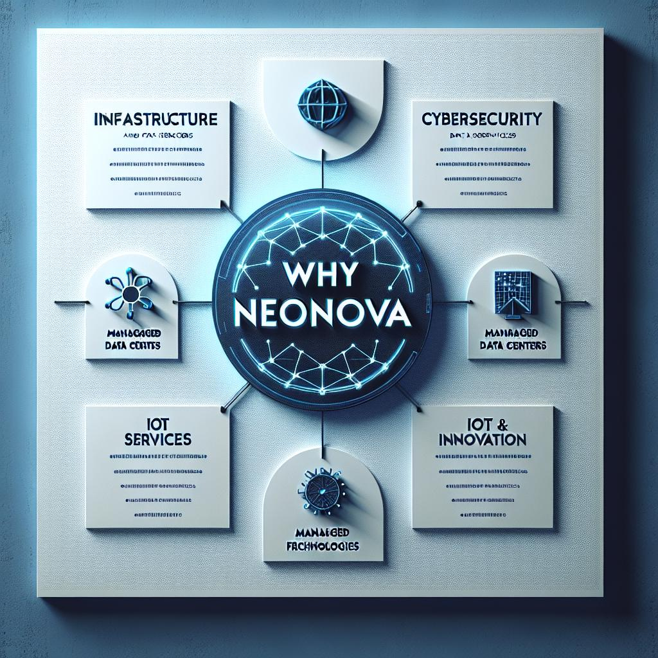
Why Choose NeoNova
1
Vision 2030 Alignment
Deep commitment to Saudi Arabia's digital transformation goals.
2
Certified Expertise
Team holds industry-recognized qualifications and specialized training.
3
Capability Building
Comprehensive cybersecurity training programs for Saudi talent.
4
Trusted Partnership
Proven track record securing Saudi Arabia's digital assets.

Slide 24


Our Trusted Partners
Collaborating with EY to enhance cybersecurity strategies.
CIMCOR provides innovative data protection solutions.
Cloudflare helps us ensure robust online security.
Notes:
This slide highlights our esteemed partners and alliances. We collaborate closely with EY to strengthen our cybersecurity strategies. CIMCOR's innovative data protection solutions complement our services, while Cloudflare ensures robust online security. These strategic alliances empower us in our mission to provide top-notch cybersecurity solutions and protect digital landscapes effectively.

Slide 25
NOENOVA – Innovating for a Secure Future. Together, we achieve more.
Address: Al-Garage, Prince Turki Bin Abdulaziz Al-Awal Road, Al-Raed, Riyadh 12354
Email: info@neonova.sa
Website: www.neonova.sa

